Slide 1
The Scanning High-resolution Interferometer Sounder (S-HIS)
Joe Taylor and the S-HIS Team
NOAA PoC/Sponsor: Satya Kalluri, Lihang Zhou
INSPYRE ER-2 Team Meeting
May 19, 2026

Slide 2
S-HIS: Team, Instrument, and Core Capabilities
Who we are:
Instrument: Scanning High-resolution Interferometer Sounder (S-HIS)
PI: Joe Taylor
NOAA POCs: Satya Kalluri, Lihang Zhou
Dave Tobin (Level 1 Radiances, Level 2 Retrievals), Elisabeth Weisz (Level 2 Retrievals), Ray Garcia (data processing and delivery), Doug Adler (mechanical engineering) Lori Borg, Dan DeSlover, Denny Hackel, Michelle Loveless (instrument/product support)
Cooperative Institute for Meteorological Satellite Studies (CIMSS), Space Science and Engineering Center (SSEC), University of Wisconsin-Madison
What we measure:
High spectral resolution infrared radiances; 580 – 2850 cm⁻¹ (3.5 – 17.3 µm), 0.48 cm⁻¹ resolution
Level 2 Dual Regression with De-Aliasing retrievals; Temperature, water vapor, CO, N₂O, CH₄, O₃ profiles; total column CO₂; surface emissivity and temperature; cloud mask, cloud top temperature, cloud top pressure
2km footprint at nadir from 20km altitude (0.100 radian field of view); ±40° cross-track swath
Platform: ER-2, centerline pod

Slide 3
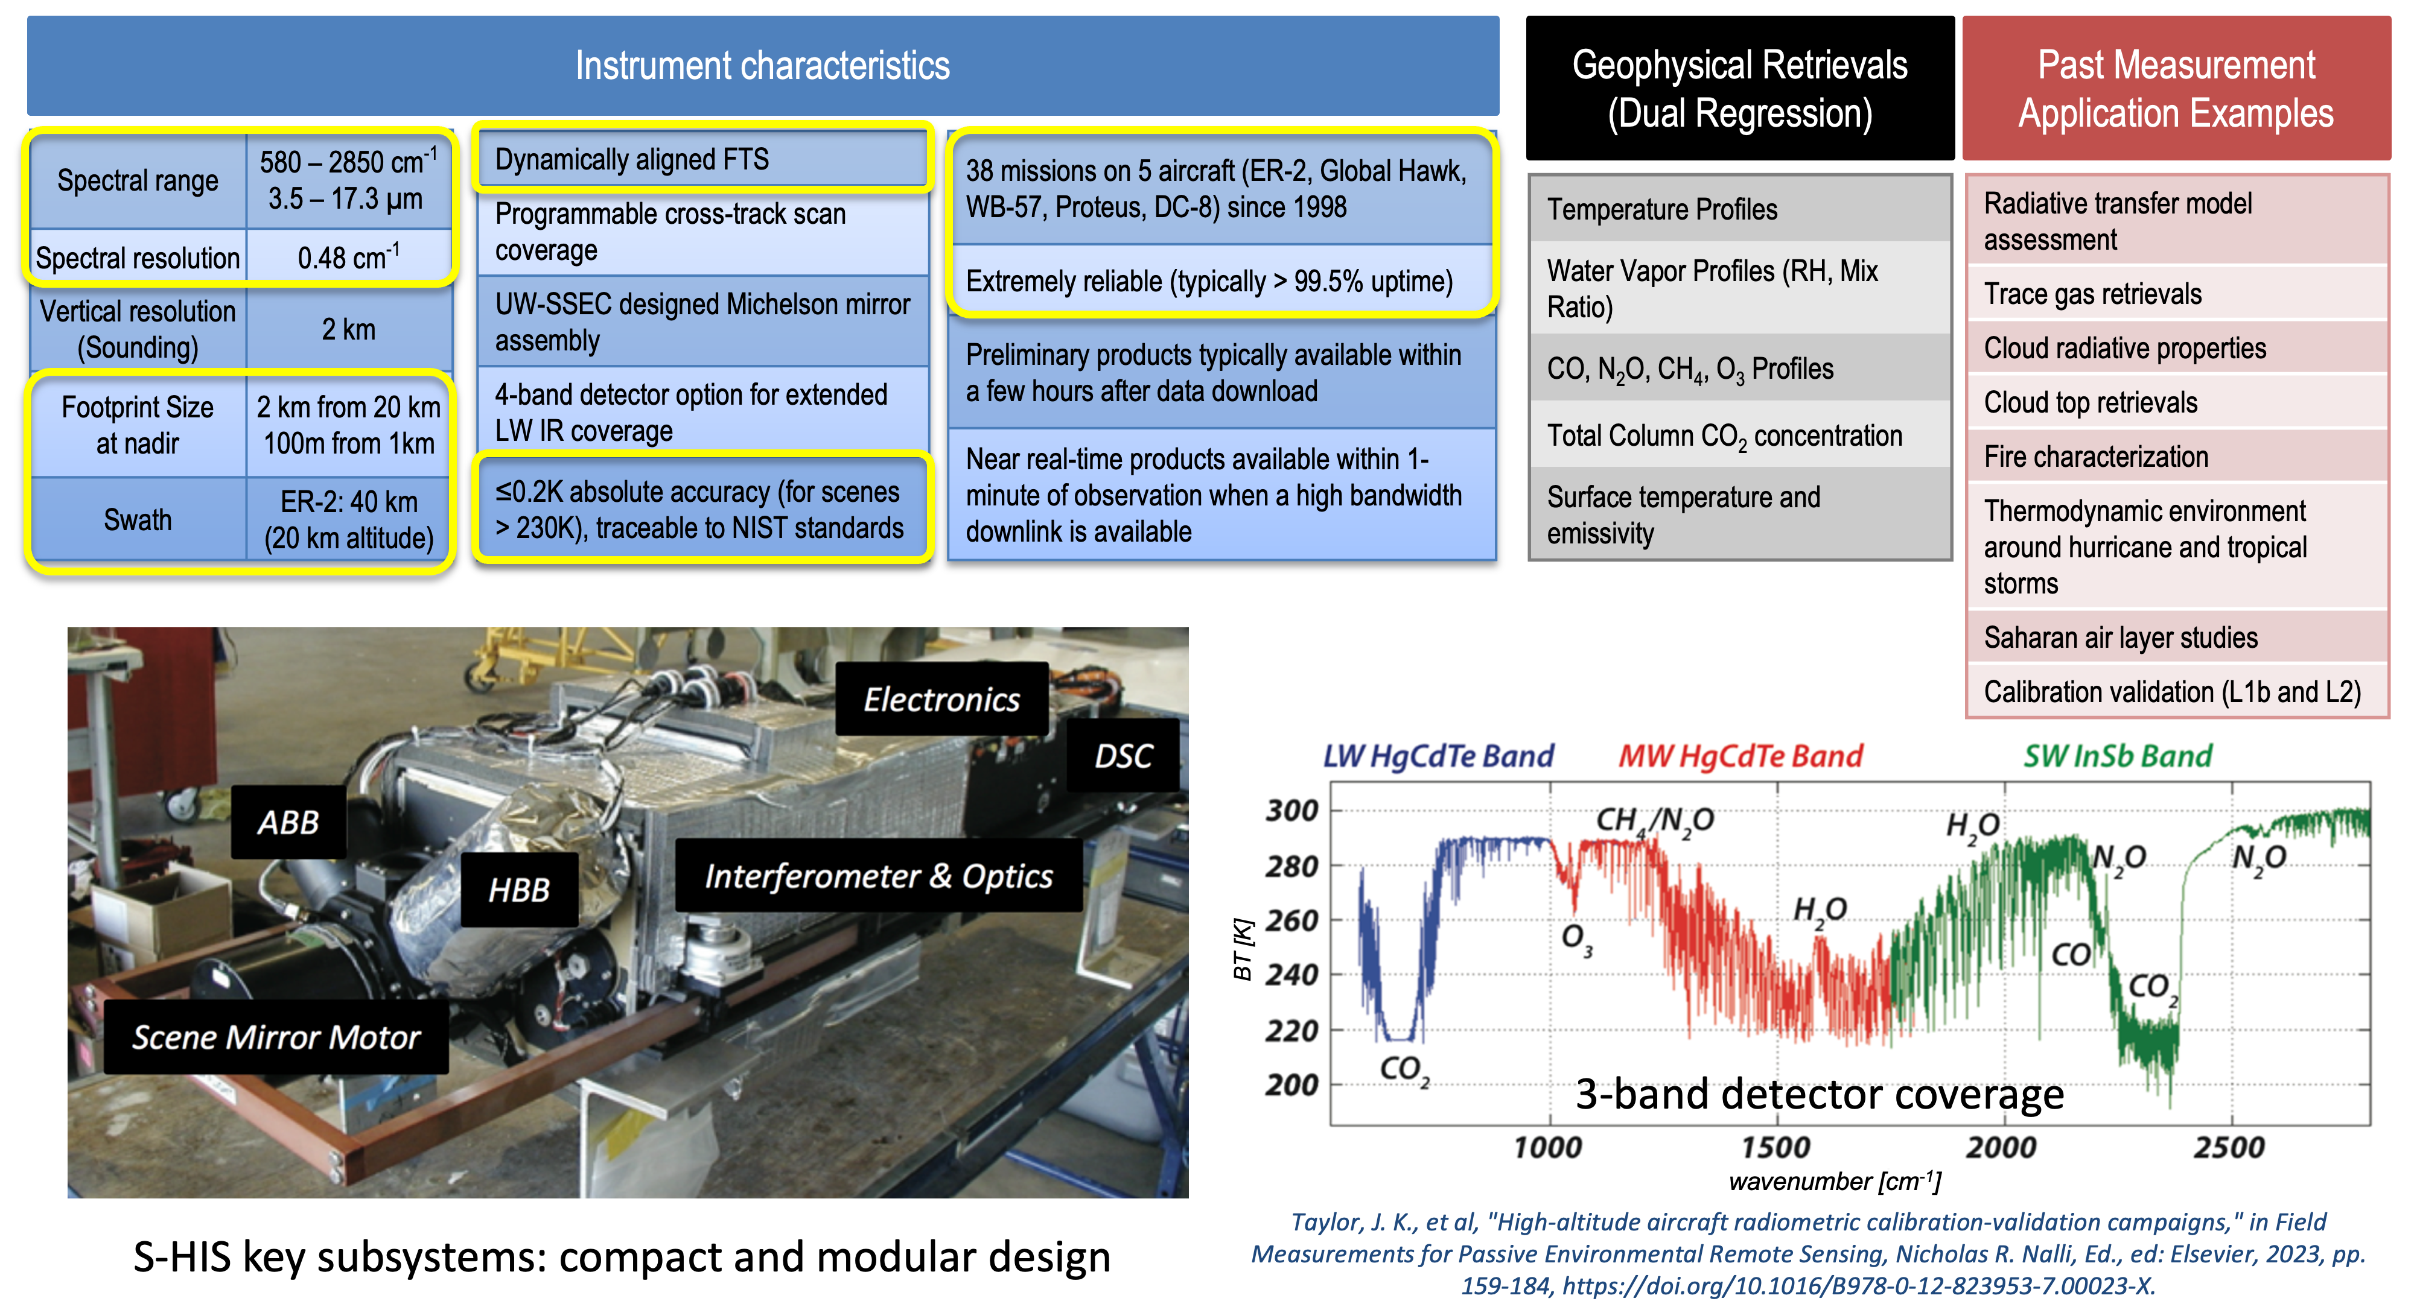
S-HIS: Scanning High-resolution Interferometer Sounder

Slide 4
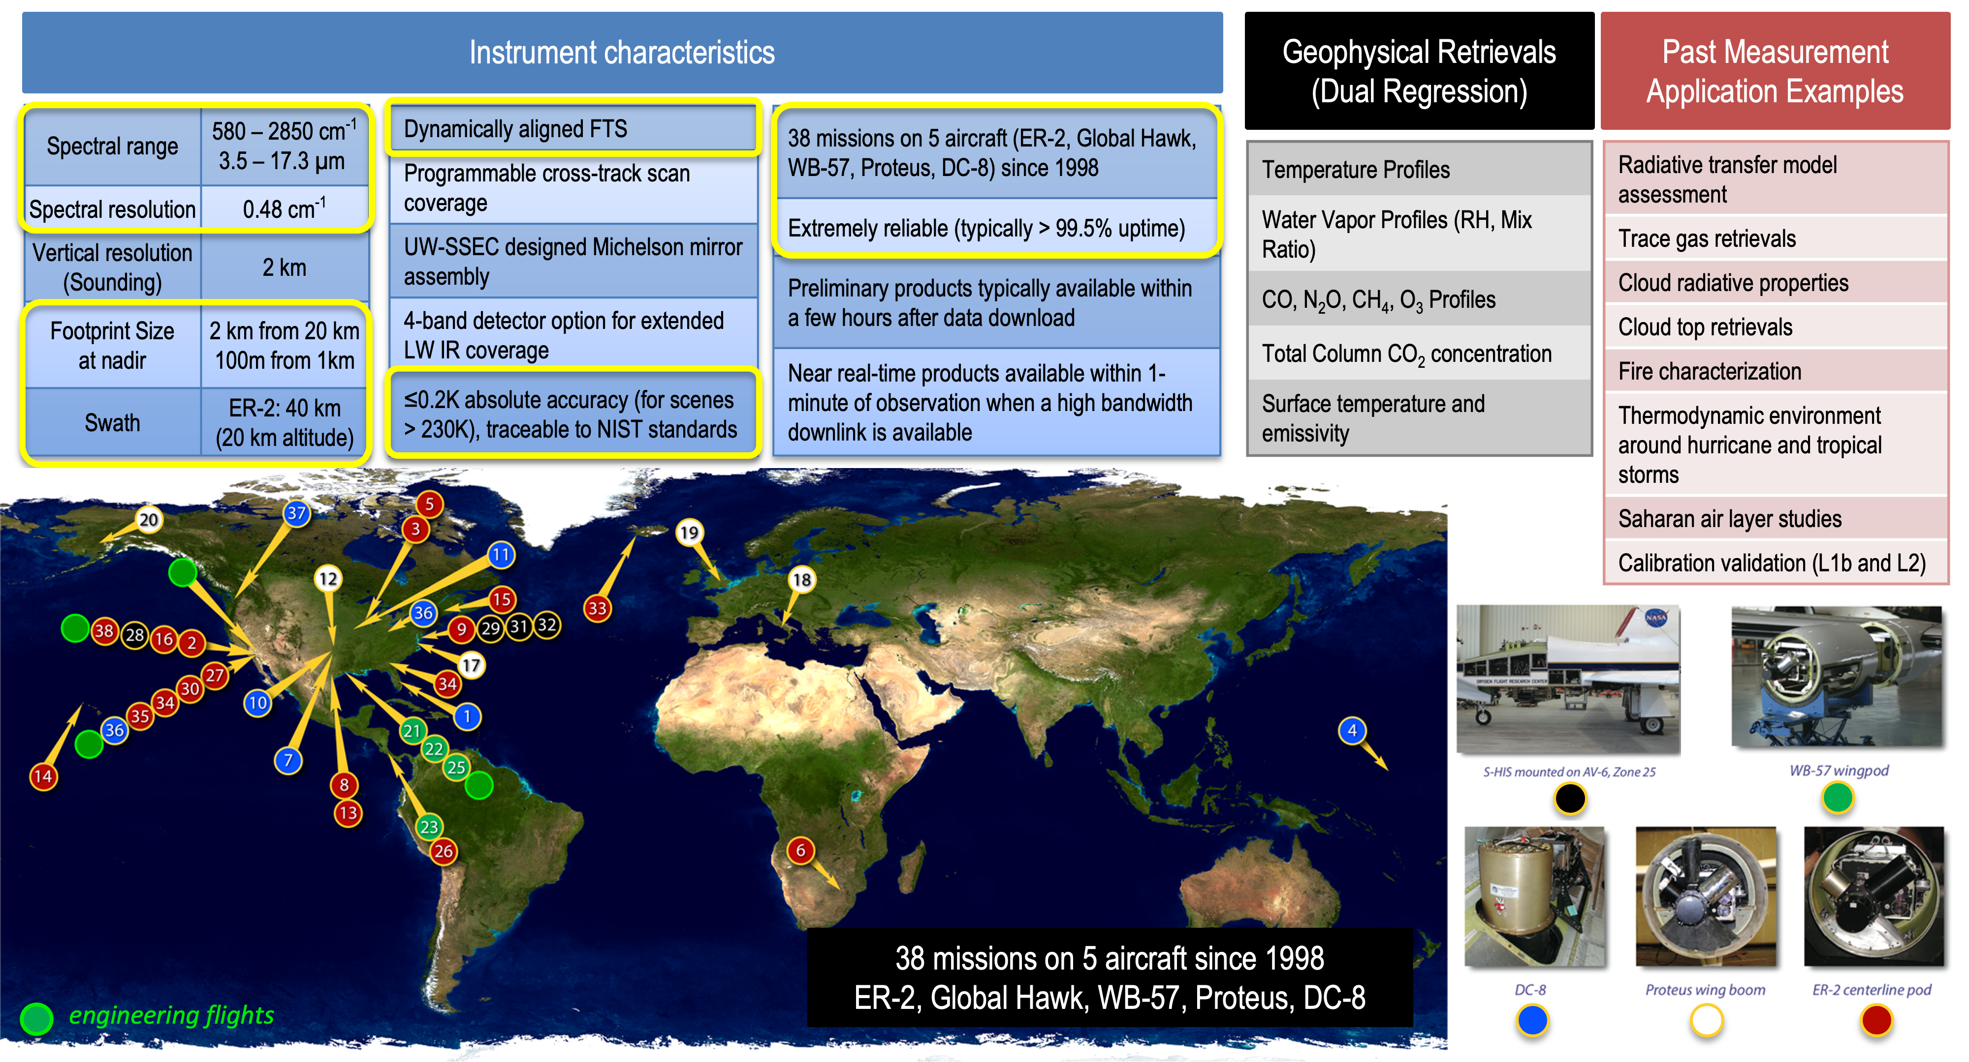
S-HIS: Scanning High-resolution Interferometer Sounder

Slide 5
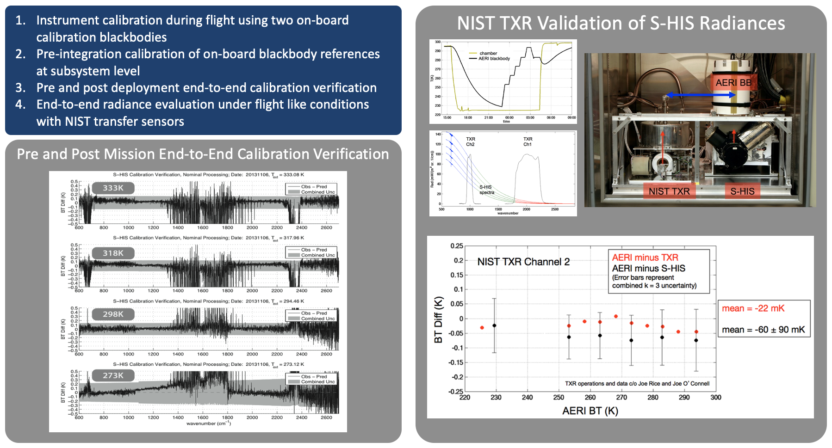
S-HIS Calibration, Calibration Verification, and Traceability

Slide 6
S-HIS: Strengths, Limits, and Unique Value
What does S-HIS do especially well?
Thermodynamic and trace gas profiling providing 3-d characterization of the atmosphere in extreme fire environments
Unmatched airborne IR sounder calibration accuracy and proven instrument reliability (38 missions, >99% uptime typical)
Key limitations or constraints
Optically thick clouds are opaque in the infrared; in the presence of dense clouds or thick smoke plumes the retrieved profiles are only valid above the cloud or smoke top
Potential for signal saturation over widespread high intensity fires
Vertical T/q profile resolution of ~1-2km
Unique contribution to INSPYRE
The S-HIS delivers atmospheric temperature and water vapor profiles, which are the mission's top-tier measurement requirements, and carbon monoxide (CO) profiles, essential for tracking smoke plume evolution and emissions
NSF/NCAR GV
(in-situ)

Slide 7
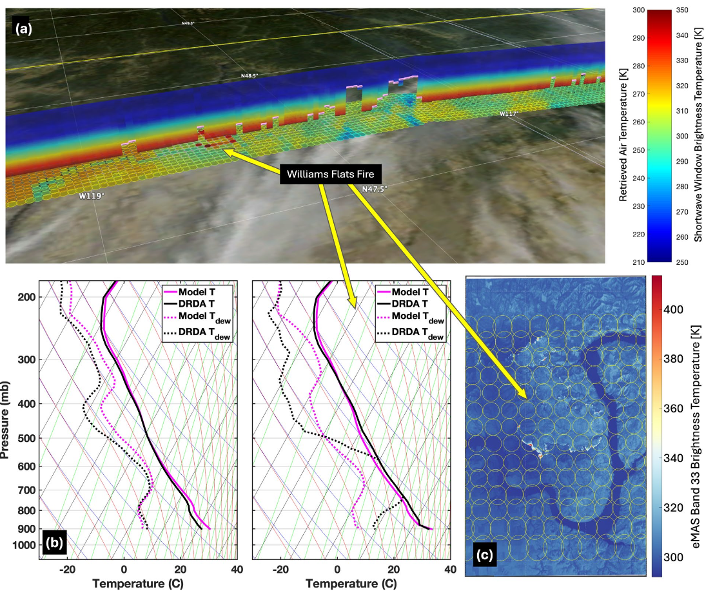
INSPYRE Science Questions and Data Use
The DRDA retrieval profiles capture high spatial resolution characteristics of the atmosphere and show a dramatic difference for footprints close to the fire, with a low-level temperature inversion, significant mid-level humidity saturation, and very high instability.
How our data can be used:
  S-HIS provides high vertical resolution constraints on atmospheric temperature and water vapor profiles. These measurements are essential for characterizing the 3D thermodynamic environment in which fires and smoke plumes evolve.
  Convective Stability and PyroCb Initiation: The retrievals are used to calculate convective stability indices, such as CAPE (Convective Available Potential Energy). It specifically constrains the conditions—such as low-level temperature inversions and mid-level humidity saturation—that lead to the explosive initiation of pyrocumulonimbus (pyroCb) events
S-HIS Observed BTs and nadir view cross-section of retrieved T profile
Collocation of the S-HIS data with the eMAS (11μm)
T/q retrieval outside fire
T/q retrieval near fire
Notes:
Panel (a): the S-HIS observed brightness temperatures for each S-HIS footprint for a transparent shortwave channel, along with the nadir view cross-section of the DRDA retrieved temperature profiles, overlaid on visible imagery from the Advanced Baseline Imager (ABI).
Panel (b): Example thermodynamic profiles are shown for near the Williams Flats fire (panel b right), and just outside the area (panel b left), for the FIREX-AQ flight from 8 August 2019 (approximately 18:15UTC).
Panel (c): Collocation of the S-HIS data with the eMAS (11μm) higher spatial resolution data (S-HIS footprint boundaries drawn in yellow) providing synergy between the high spatial resolution surface/fire extent and temperature observations and the thermodynamic profile data.
The DRDA retrieval profiles capture high spatial resolution characteristics of the atmosphere and show a dramatic difference for footprints close to the fire, with a low-level temperature inversion, significant mid-level humidity saturation, and very high instability.

Slide 8
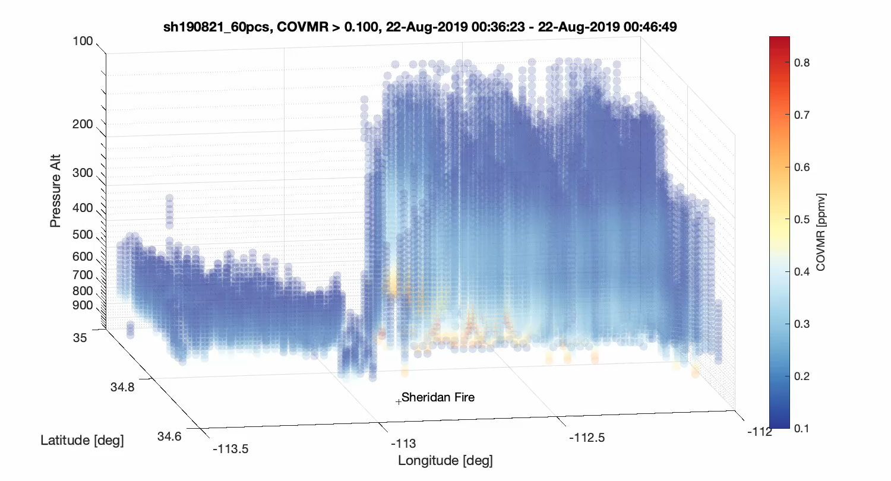
INSPYRE Science Questions and Data Use
How our data can be used:
  Emission and Plume Evolution: S-HIS retrievals of carbon monoxide (CO) profiles, along with the detection of trace gases, are used to track and quantify fire emission processes and the subsequent evolution of smoke plumes.
  Cloud and Surface Radiative Properties: The measurements constrain surface skin temperature, surface emissivity, and cloud radiative properties. It also retrieves cloud-top pressure and height, which are vital for determining the vertical extent of smoke and clouds
Example CO retrieval for the 5th overpass of the Sheridan fire
Retrieved (Dual Regression) CO VMR (ppmv) for the 5th pass near the Sheridan fire
Showing retrieved values with increasing minimum CO VMR plot threshold
Illustrates the 3-dimensional nature of the retrieved parameters

Slide 9
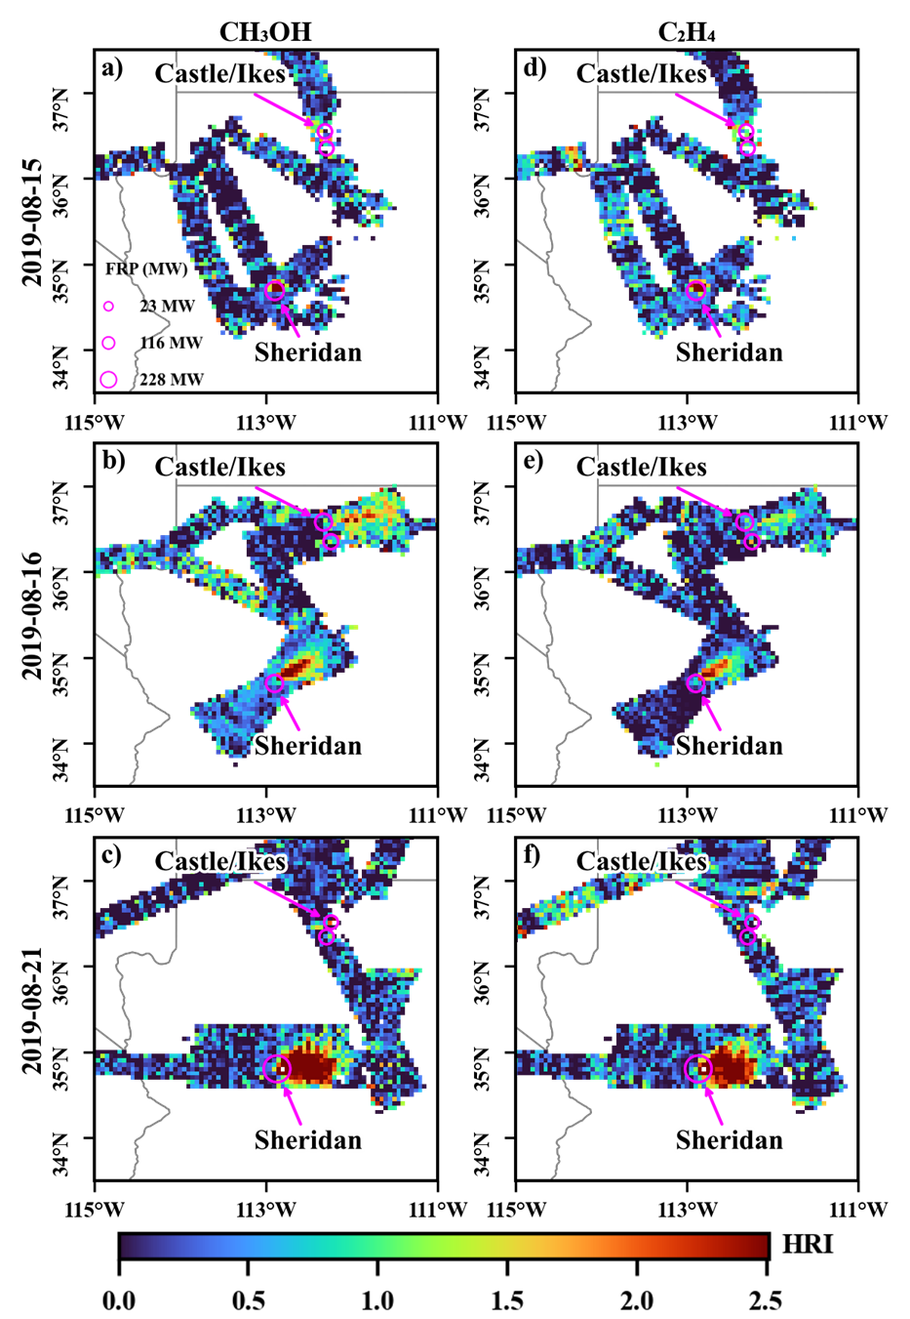
INSPYRE Science Questions and Data Use
How our data can be used:
  VOC measurements: Aircraft-based high spectral resolution thermal infrared observations can be used to detect and characterize VOC enhancements in fire plumes
  Hu et al have developed the first aircraft-based thermal IR VOC retrievals using radiance observations from the Scanning High-resolution Interferometer Sounder (S-HIS) during the 2019 FIREX-AQ campaign.
  Focusing on methanol and ethene, two of the most abundant chemicals emitted by fires, they have assessed the utility of this approach for mapping wildfire VOCs
  C. Hu et al. (2026), Journal of Geophysical Research: Atmospheres,131, e2025JD045605. https://doi.org/10.1029/2025JD045605
Airborne remote sensing maps reactive fire emissions and their downwind transport.

Slide 10
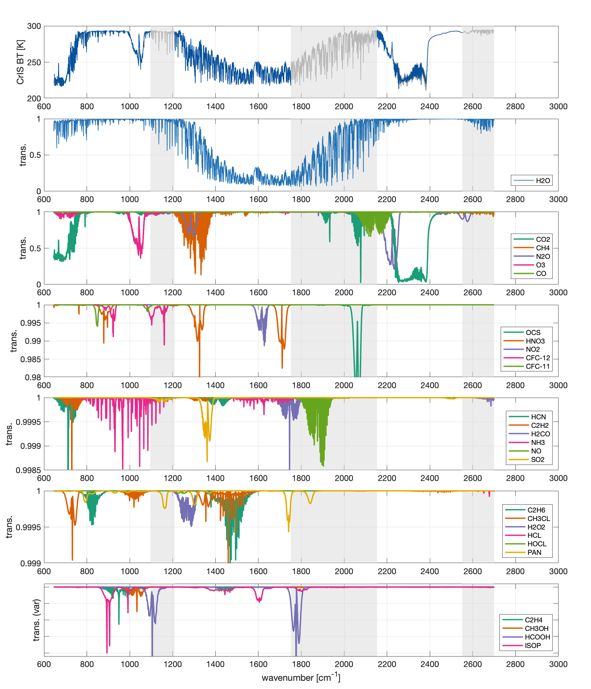
INSPYRE Science Questions and Data Use
CrIS Coverage Shown; S-HIS coverage is 580 – 2850 cm⁻¹ with no gaps
Airborne remote sensing maps reactive fire emissions and their downwind transport.

Slide 11
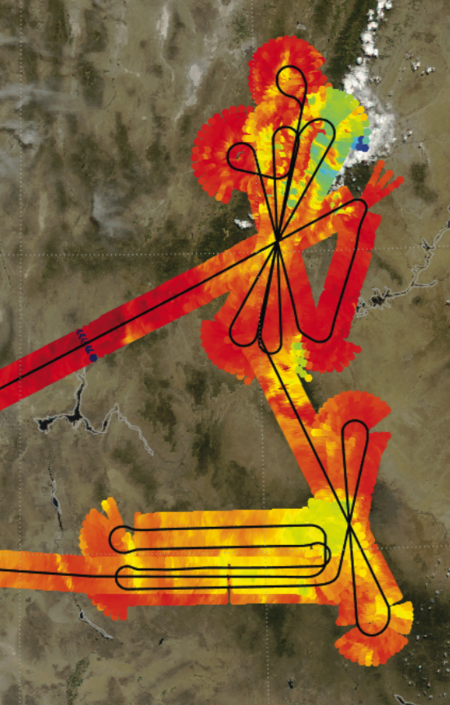
Measurement Approach and Operational Needs
Preferred observing strategy
  High-altitude straight and level legs (ER-2; remote sensing instrument)
  Lawnmower pattern over target to capture full plume extent or Lagrangian sampling of downwind plume detached from convection
  Multiple dog-bone or bow-tie passes over target to capture temporal evolution of the atmospheric environment near the target
  Pre/during/post pyroCb event to capture life-cycle of evolution leading to and after event
  Highest quality data collection is expected for straight and level legs, but S-HIS has also proven to collect high-quality data during smooth turns/banking (roll)
2019-08-21
Logistical constraints
  Icing and condensation
    Descent from cold and dry at-altitude atmosphere into warmer and more humid air layer creates the risk for condensation and icing. We have ”descent” heaters that are activated for final descent - these heaters protect sensitive elements from condensation damage. If a stacked dog-bone is to be flown, we will need to assess whether the descent heaters need to be activated. Activation of the heaters will impact data product availability.
  Thermal impacts of rapid and large changes in altitude (aircraft vertical profiles)
    Radiometric accuracy will depend on the temperatures of each onboard calibration reference body, the temperature difference between the two bodies (one heated, one ambient), and the temperature stability of the instrument and calibration references between calibration views.
Notes:
FASMEE burn area, Sheridan, Little Bear, Castle, Ikes Fires

Slide 12
Measurement Approach and Operational Needs
Critical dependencies
  A priori model for DRDA retrieval
  Aircraft nav data for geolocation of products
Nice-to-have
  co-located infrared imager (i.e., MASTER)
  co-located lidar measurement (i.e., CPL)
  in-situ measurements of trace gases for retrieval validation
  under-flights of LEO high spectral resolution infrared measurements (CrIS, IASI, IASI-NG, AIRS, GOSAT-1/2)
If missing, what breaks?
  S-HIS provides high vertical resolution constraints on atmospheric temperature and water vapor profiles. These measurements are essential for characterizing the 3D thermodynamic environment.

Slide 13
INSPYRE Science Questions and Data Use
Relevant INSPYRE science question(s)
Q1: Determine the fire conditions that produce pyroCbs and why
  thermodynamic profiles (temperature, humidity); instability indices and low-level temperature inversions
  plume vertical and horizontal structure (and plume dynamics with multiple overpasses); CO and other VOCs
Q3: Assess how pyroCb-injected smoke plumes alter the upper troposphere and lower stratosphere (UTLS)
  water vapor concentration
  CO, CO₂, CH₄ concentrations

