Slide 1
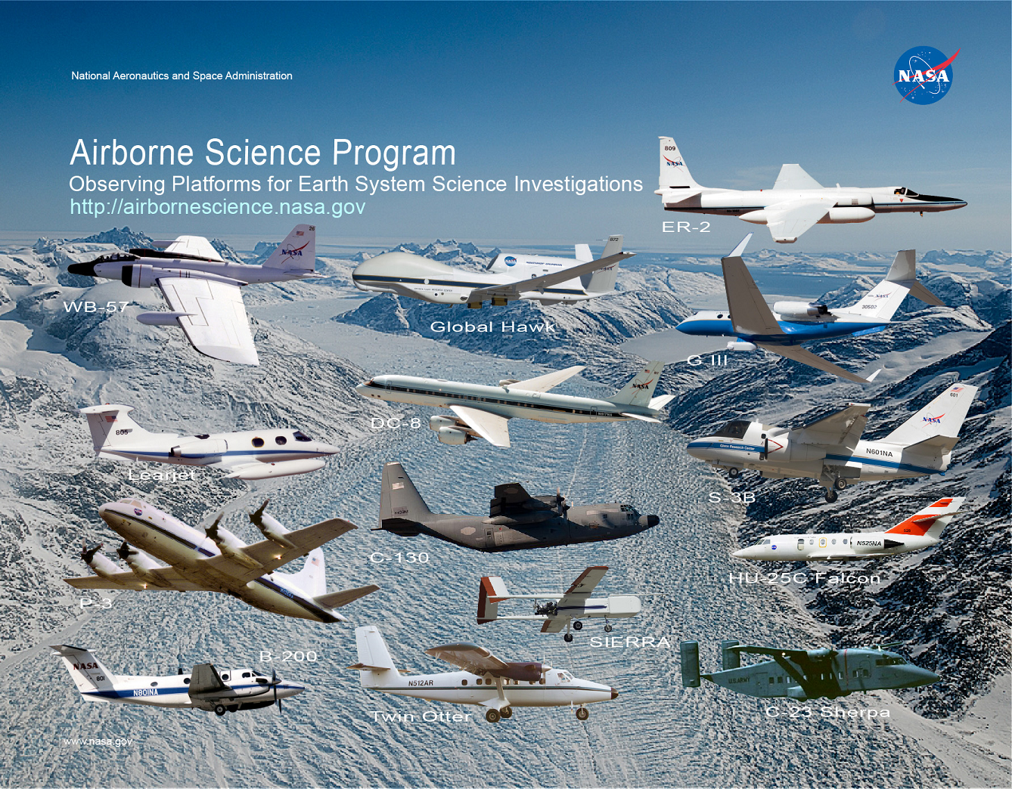
NAMS Earth Science Program Update
3/29/2019

Slide 2
Outline
Overview of the Ames Airborne Sensor Facility (ASF)
Earth Observation System (EOS) Support Element
Airborne Science Program (ASP) Support Element
Summary of Mission Activities Under NAMS
USRA / NASA Collaboration Projects

Slide 3

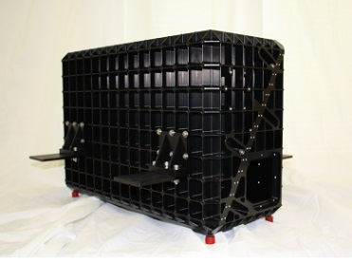
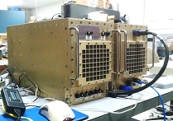
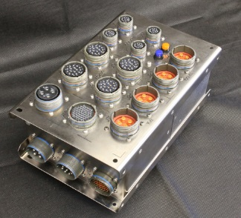
The Airborne Sensor Facility at NASA Ames Research Center
EOS / ASP Facility Sensor Systems
Development and operation of a suite of remote sensing
systems for satellite cal/val, algorithm development, and
fundamental Earth science process studies
(EMAS, MASTER, PICARD, GPS/IMUs, Digital Cameras)
ASP Real-time Sensor Network Development
SAT-Com based payload communication and control
systems, that increase the productivity of the core NASA
science aircraft
ASP Payload Engineering Support
Cross-center instrument integration support (EE, ME, IT)
EOS Optical Calibration Laboratory
NIST-traceable characterizations of airborne imaging devices
The ASF is jointly supported by the EOS Project Science Office and the Airborne Science Program
PICARD Imaging Spectrometer
Hardware development
(New EMAS Data System)
Standard Payload Interfaces
Spectral Calibration
Notes:
3

Slide 4
Airborne Sensor Facility USRA/NAMS Staff
NASA Ames & Armstrong Research Centers
20 USRA WYE
(Co-funded by EOS-Project Science Office and the Airborne Science Program)
Task Manager
Admin Asst.
Sensor Engineering (6)
EMAS, MASTER, PICARD instrument support
Sr. Sensor Engineers (2)
Optical Engineer
Jr. Elect. Engineer
Sensor Technicians (2)
ASF at AFRC/Palmdale-703 (6)
Airborne Sensor Network Operations
and Instrument Support
Avionics Engineer
Sensor Network Engineer (GHOC CSA)
Data Analyst
Sensor Technicians (2)
Telemetry Systems Engineer (Global Hawk reimbursable)
Data & Mission Operations (6)
L1-1B data production, field operations, software
development & IT support
Sr. Data Analysts (2)
Data Analysts (2)
Software Engineer (Zheng)
Network Admin./CSA (Windham)
Key Interfaces
NASA ARC Task Requestor: Matt Fladeland (Code SG)
EOS Senior Project Scientist: Steve Platnick
Airborne Science Program Manager: Bruce Tagg
Contract NNA16BD14CNAMS
Tasks CLIN3D and 115 (Earth Science)

Slide 5
Airborne Sensor Facility
Earth Observing System
Support Element

Slide 6
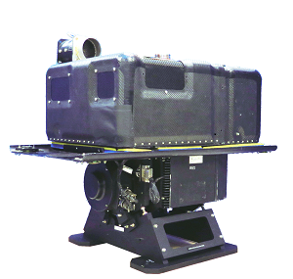
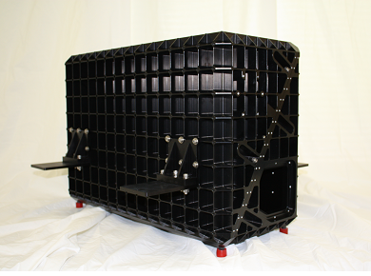
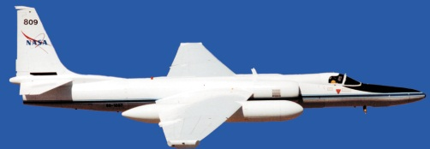
The Enhanced MODIS Airborne Simulator and the PICARD Imaging Spectrometer
EOS/ESD facility instruments intended to:
Simulate existing satellite imager products (MODIS/VIIRS)
Validate radiances and geophysical retrievals
(emphasis on cloud and aerosol science)
Prototype future imager requirements and algorithms (e.g., PACE, ACE)
Contribute to multi-disciplinary NASA field studies
EMAS: The Enhanced MODIS Airborne Simulator - an imager with high spatial resolution and broad spectral coverage (12 bands 6.7 – 13.9μm, 3.7μm, and 25 bands 448-2400nm)
PICARD: The Push-broom Imager for Cloud and Aerosol Research and Development
A wide-FOV VNIR/SWIR imaging spectrometer (205 bands 400 – 2450nm)
EMAS
PICARD HSI
ER-2 Aircraft

Slide 7
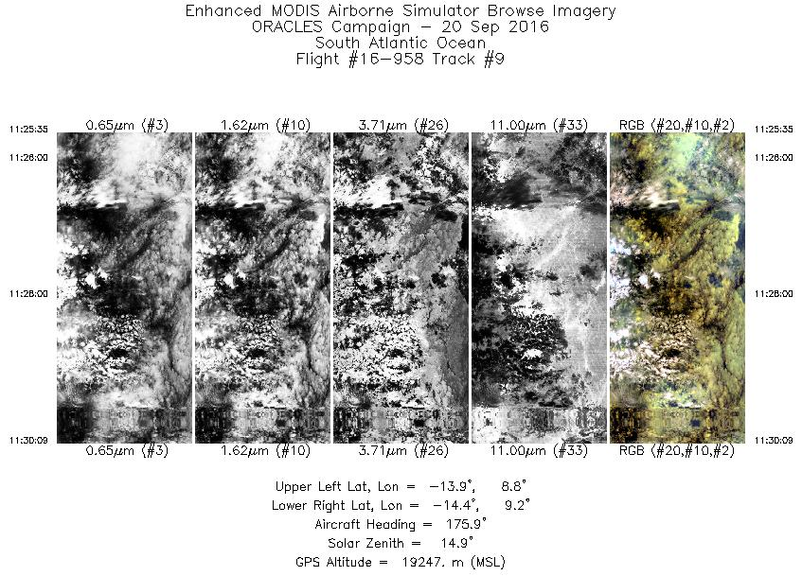
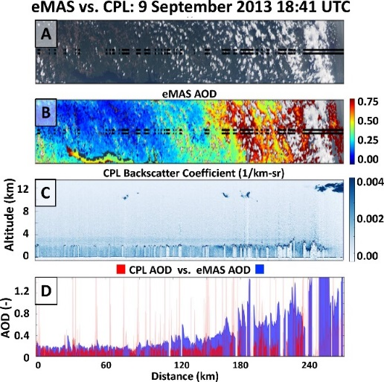
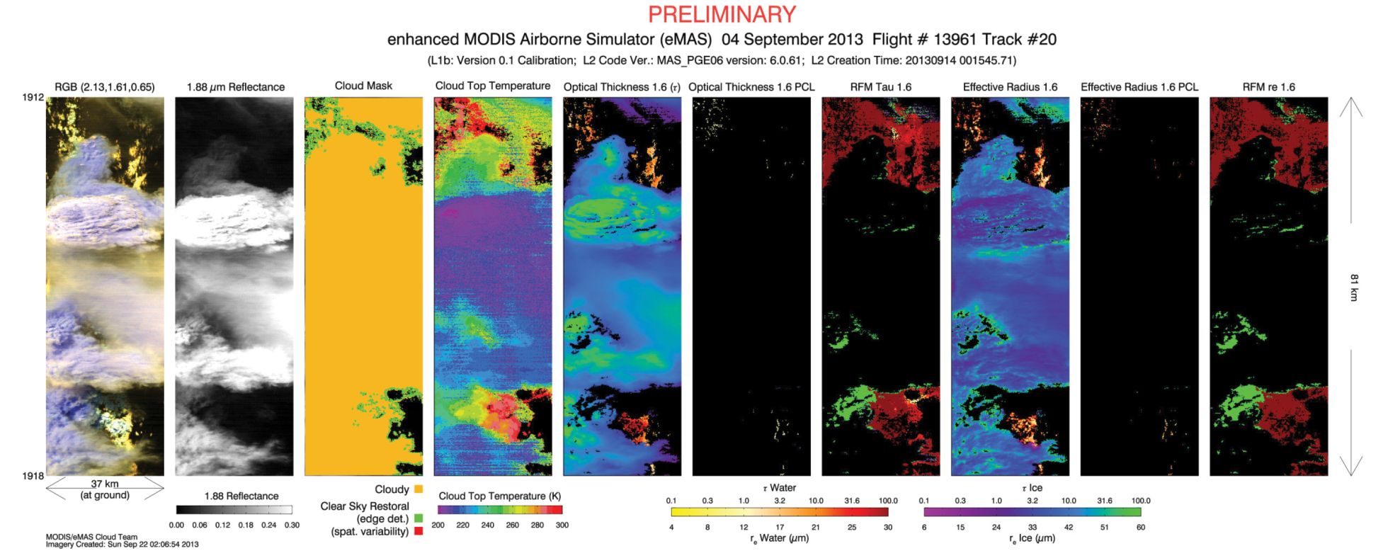
Standard EMAS Cloud Data Products
L-1 Quick-Look Product
L-2 Cloud Products –SEAC4RS
(GSFC MODIS
Atmospheres Team)

Slide 8
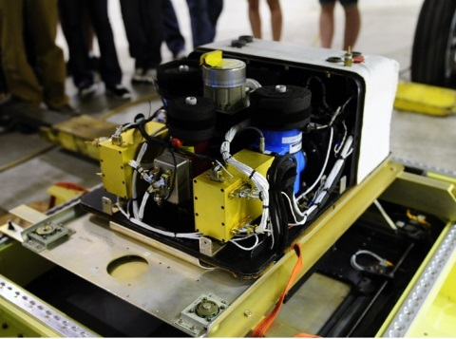
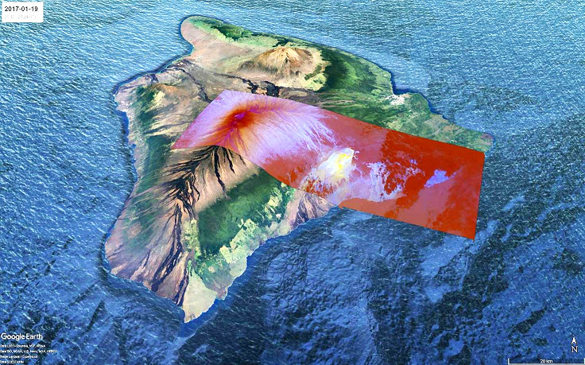
MODIS/ASTER Airborne Simulator (MASTER)
An airborne imager with high spatial resolution and broad multi-spectral (VNIR, SWIR MWIR, LWIR) coverage, used to:
Simulate ASTER, MODIS, and HyspIRI satellite imager products
Validate radiances and land-surface geophysical retrievals
Prototype future imager requirements and algorithms (e.g., HyspIRI/SBG)
Support multi-disciplinary Earth Science process studies
Includes 50 spectral bands between 430nm and 13.1μm, with 14 MWIR bands between 3.2μm and 5.3μm, and a dual-gain 4μm band
Variable spatial resolutions from 3 – 50 meters, flying on ER-2, DC-8, P-3B, others
SO2 Retrievals
Kilauea, HI
(JPL)
MASTER on DC-8

Slide 9
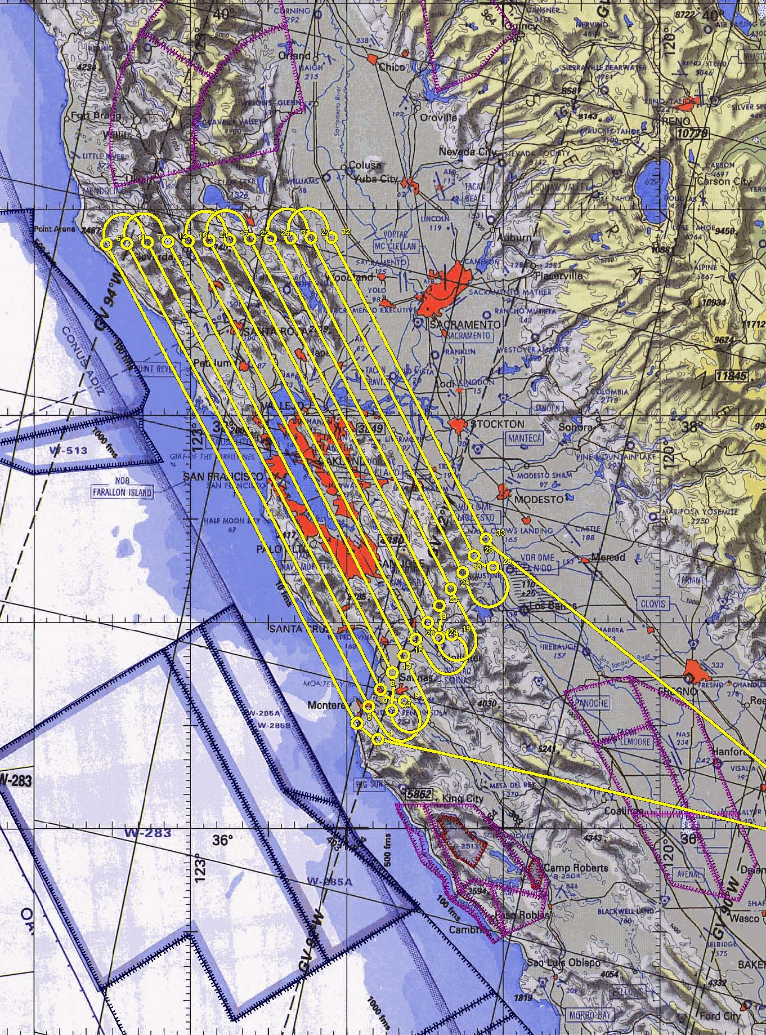
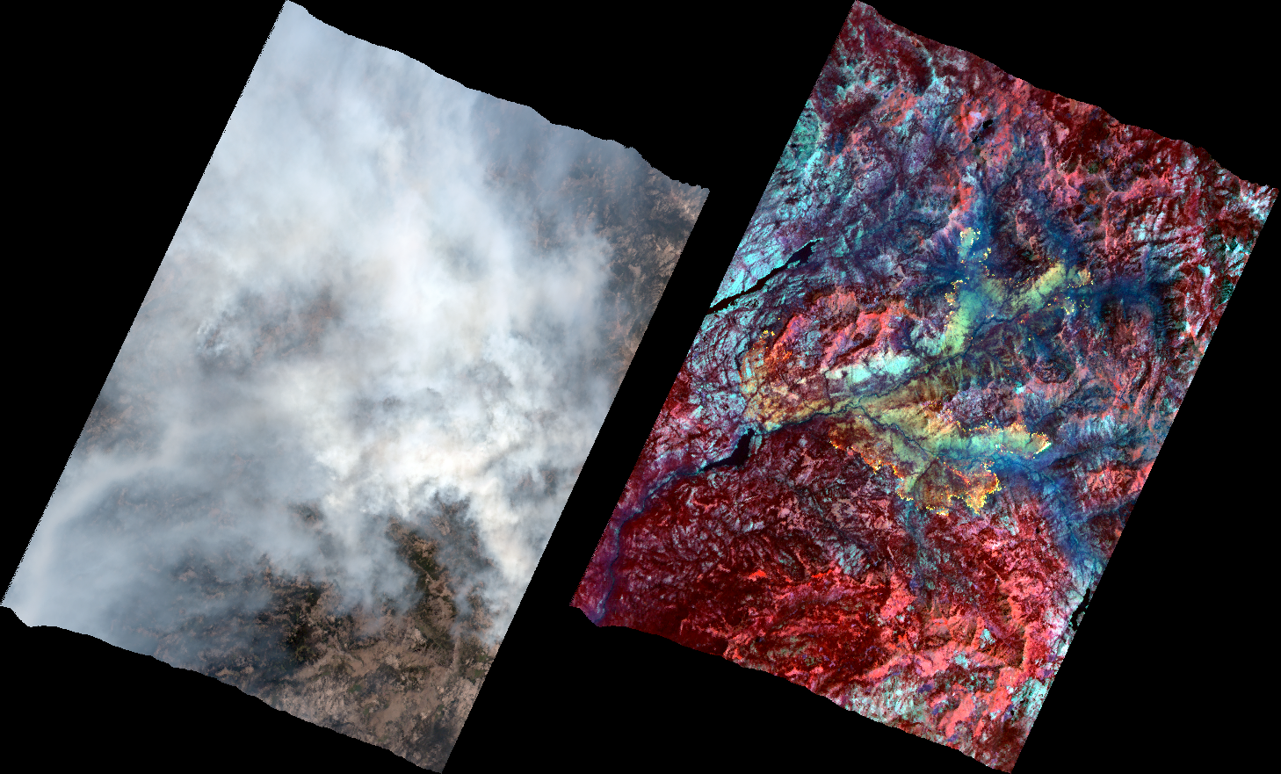
MASTER
HyspIRI Precursor Data Sets
ER-2 Flight Plan
(“Bay Area Box”)
R-G-B
MW/LWIR
Visible
Donnells Fire 8/9/2018

Slide 10
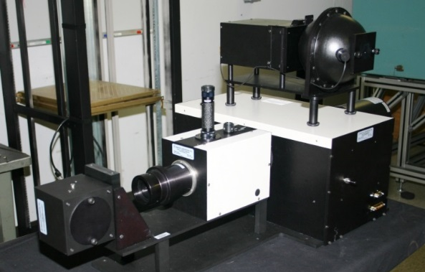
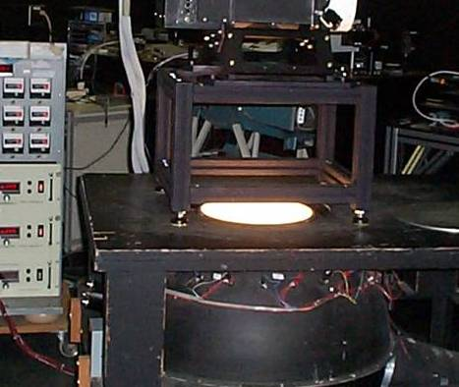
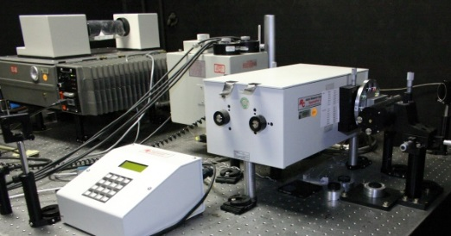
ASF Sensor Calibration Lab
A NIST-Traceable Calibration Facility for Airborne Sensors
Spectral & Radiometric Characterizations from 350nm – 14mm
Annual GSFC validation and oversight by the EOS Calibration Scientist
Supports multiple NASA centers
Currently supporting:
EMAS, PICARD, MASTER
Research Scanning Polarimeter (GISS)
4/5-STAR Tracking Sun Photometers
SSFR Solar Spectral Flux Radiometers
Field Spectro-Radiometers
Transfer Radiometer
Spectral Sources
Integrating Spheres
FTIR and Monochromator sources
V/SWIR Transfer Radiometer
Integrating spheres
Field-portable hemispheres
Extended—area and High-Temp BB sources
12” Collimator & Optical Bench

Slide 11
Airborne Sensor Facility
Airborne Science Program Support Element

Slide 12


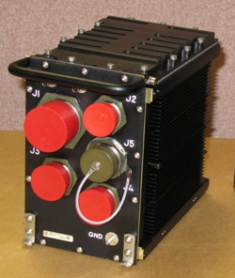
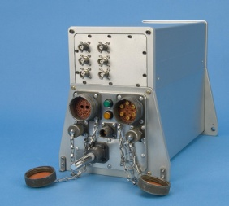
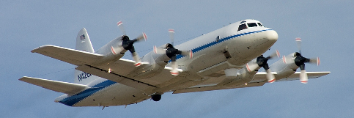

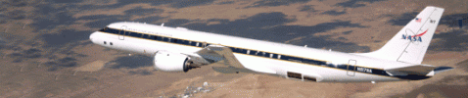
The Airborne Science Sensor Network System
Extending real-time sensor webs to NASA science aircraft
Ethernet
Experiment Interface Panels
Auxiliary Processor & Mass Storage
ER-2
NASDAT Network Server
Payload Instrument
Payload Instrument
Ethernet
Ethernet
Ethernet
Payload Instrument
Ku-Band Sat-Com
Iridium/Inmarsat
Real-time Remote Operators
NASA Mission Tools Suite
Ground Networks
P-3B
ER-2
DC-8
Notes:
Hardware developed under ARRA; Software partly includes AIST efforts (Don Sullivan, et al)
Offers standardized hardware and software interfaces for investigator instruments

Slide 13
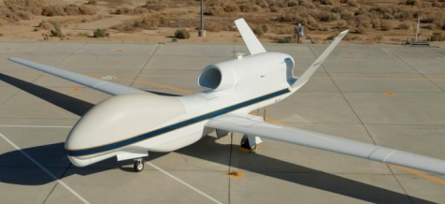

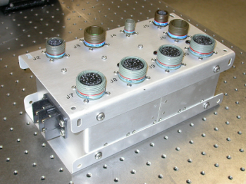


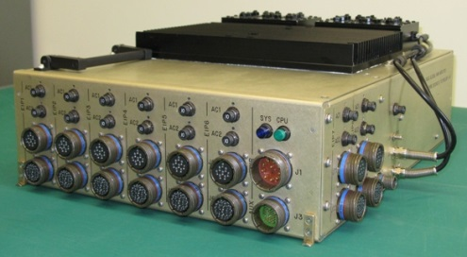
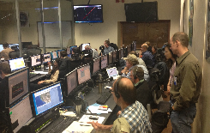
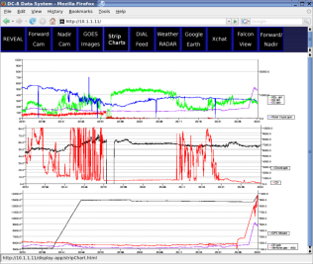
Global Hawk APCS
Instrument Power & Control
AC-DC TRUs
Aircraft HW
Interface Panels (8)
Payload Instruments
Master Payload Control System
& PDU
GHOC HW
EIP
Ethernet
PI Hardware
NASDAT
Network Server
Database & Ku Telemetry Controller
Link Module
AIRCRAFT
GROUND
MPCS
Iridium (4 ch)
Ku-Band Sat-Com
Iridium (2 ch)
Global Hawk Ground Operations Center
Flight Deck
Web-Based Users
Science Data Servers
Payload Control GUI (Pilot /
Mission Director)
Experimenter Workstations

Slide 14

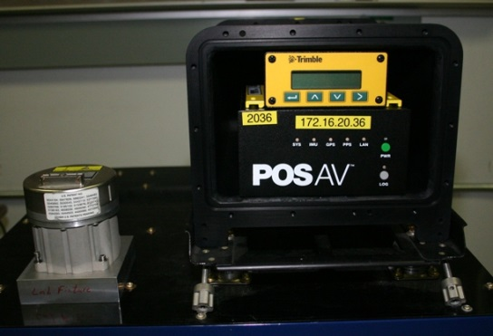
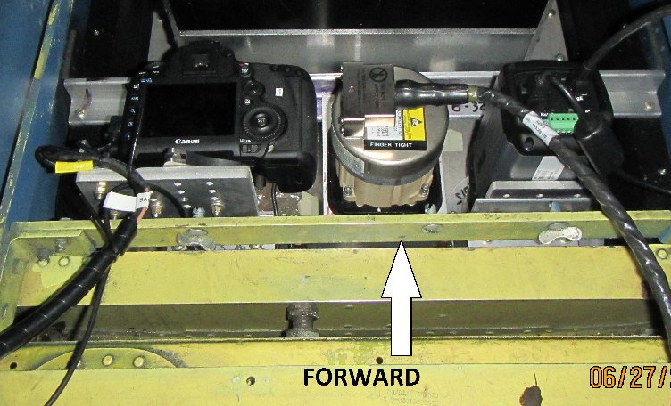
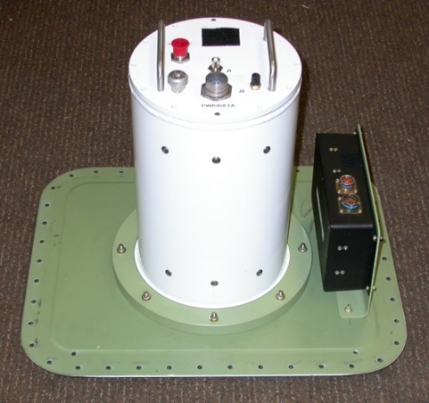
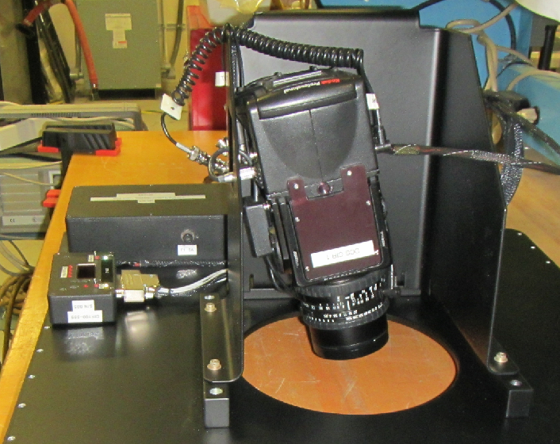
Misc. ASP Facility Sensor Equipment
Electro-Optic and Video Cameras, Precision GPS & Attitude Reference Systems
Applanix POS-AV 610/510
IceBridge DMS Cameras (P-3B)
Pressurized
Camera Cannister
DCS Camera in Tilt-Mount
for JPL AirSWOT (B200)

Slide 15
Airborne Sensor Facility
Summary of Mission Activities
Under NAMS

Slide 16
Instrument Operations
(Under NAMS 2016-2018)
MASTER Missions (ER-2, DC-8)
Year | FY Flights
2018 | 27
2017 | 27
2016 | 12
Total | 66
EMAS Missions (ER-2)
Year | FY Flights
2018 | 3
2017 | 1
2016 | 28
Total | 32
DMS Missions (DC-8, P-3B)
Year | FY Flights
2018 | 24
2017 | 73
2016 | 56
Total | 153

Slide 17
Airborne Sensor Network Operations
and Applanix Loan Support
ASP Sensor Network (Campaigns supported)
HyspIRI (ER2 2016, 2017, 2018)
MisTIC Winds ER-2 2018)
SARP (ER2 2016, 2017, 2018)
ACEPOL (ER2 2017)
GOES-R Field Campaign (ER2 2017)
ORACLES (ER2 2016)
HAP (ER2 2016, AirMSPI)
Applanix Loaner Support
Operation IceBridge (all)
Carafe (NASDAT & Applanix, WFF Sherpa)
OMG EV-2 GLISTIN (Applanix, JSC GIII)
DopplerSCATT (Applanix, JPL)
UAVSAR (Applanix, G-III)
HALO (Applanix, Langley)
Long Island Tropospheric Ozone (Applanix, Langley)
Global Hawk Campaigns
NASA: SHOUT – (WFF, 2016) & HOPE-EPOCH (AFRC, 2017)
DoD: TM Demo – Hawaii (2017)

Slide 18
FY2018 ER-2 Instrument Integration Support
New instrument network integrations:
AVIRIS-NG**
HyTES**
CAMAL**
PRISM**
AirHARP **
Air-LUSI**
MSFC PV Solar Cells
** denotes ESTO-funded projects

Slide 19
USRA NAMS Collaborative Efforts

Slide 20
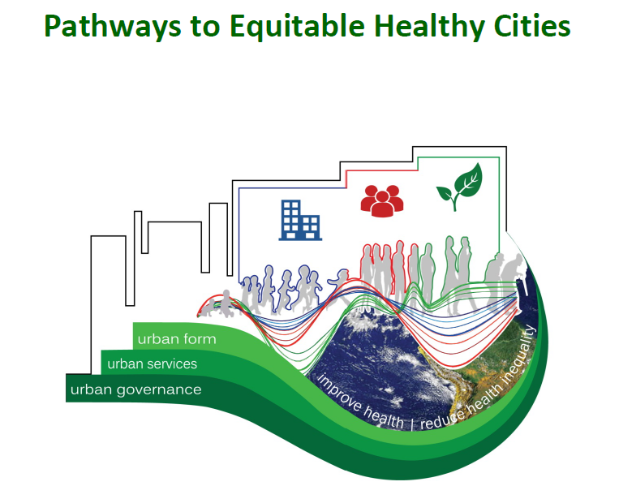
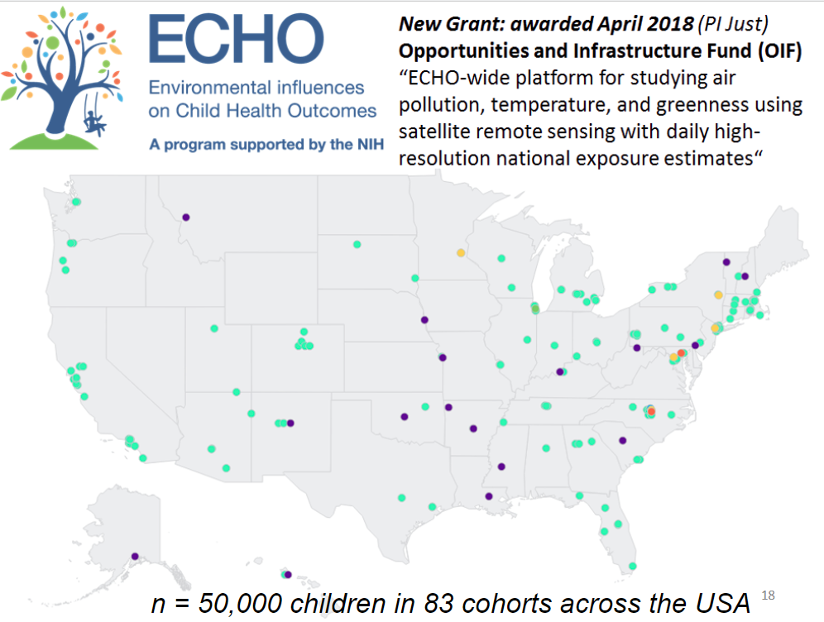
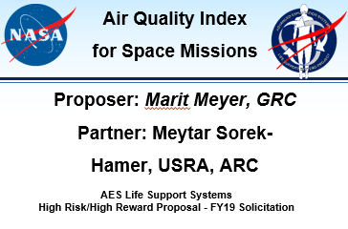
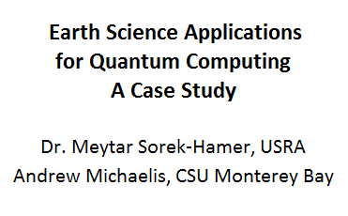
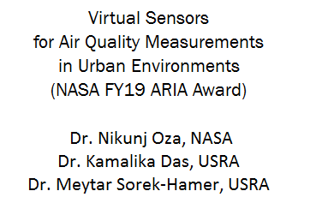


USRA Funded Visiting Environmental Scientist Program
(1st Hire 8/1/2018, 2nd Hire 2/1/2019)
Welcome Trust – Imperial College – UBC – USRA
NIH – Mt. Sinai Icahn School of Medicine – USRA
ECHO Consortium on Perinatal Programming of Neurodevelopment
(Phase I Awarded & Phase II Awarded)
NASA Funding
Core Cities – London, Vancouver, Accra, Dhaka, Beijing, Teheran
35 Cities Including – Atlanta, Boston, Chicago, Los Angeles,
New York, San Francisco, Washington DC
USRA PI – Dr. Meytar Sorek-Hamer
USRA PI – Dr. Meytar Sorek-Hamer
Lead analysis with machine learning/deep learning to characterize within-city variability with air pollution levels and sources, open sewers, waste sites, greenness, housing quality/poverty, road safety, …
Correlating risk factors and mitigating factors such as the effect of diet (e.g, vitamin C, anti-inflammatory fatty acids) on exposure to air pollution and chemical toxicities. Small part of a 5-Year $43M NIH Grant.
… 1.5+ WYE Funding to Date

Slide 21

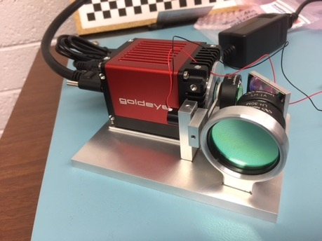
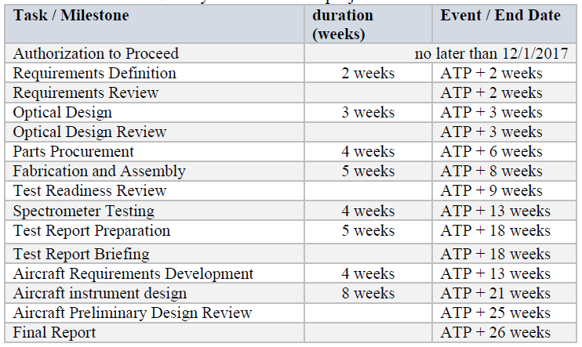
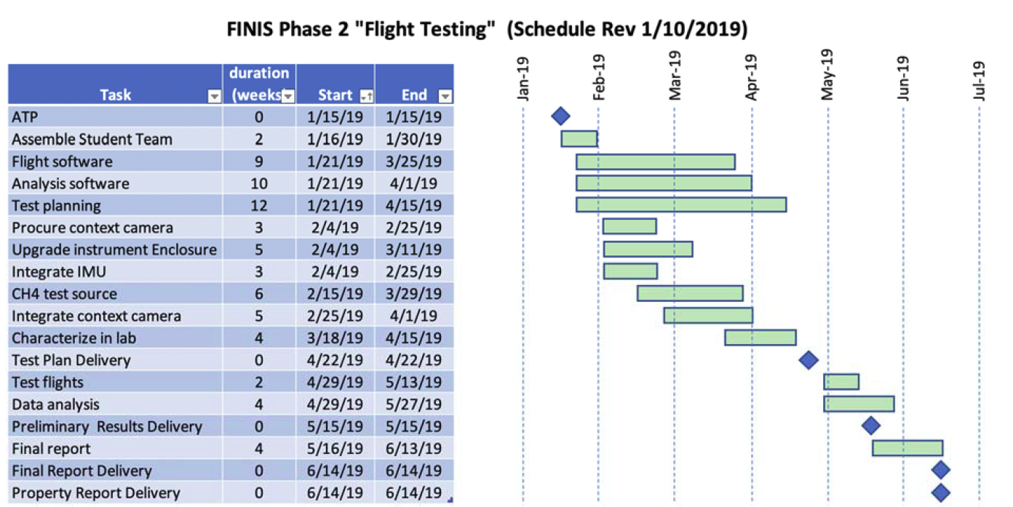
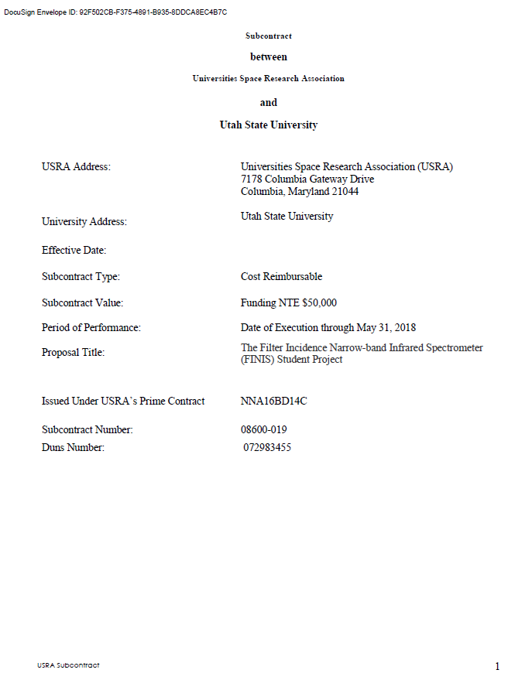

Joint NASA/USRA Funded IRAD for Methane Instrument Development and Airborne Flight Testing
Prof. Charles Swenson
Center for Space Engineering
Utah State University
FINIS Phase I Deliverables (SRR, CDR, TRR)
Laboratory testing capability for 4 ppm methane measurements as observed from space with a nadir view and 60 deg solar elevation.
Initial Subcontract Fully Executed 12/11/2017
Contract Mod for NAMS Option Period Implemented
Mod for Airborne Flight Experiment – signatures imminent

Slide 22
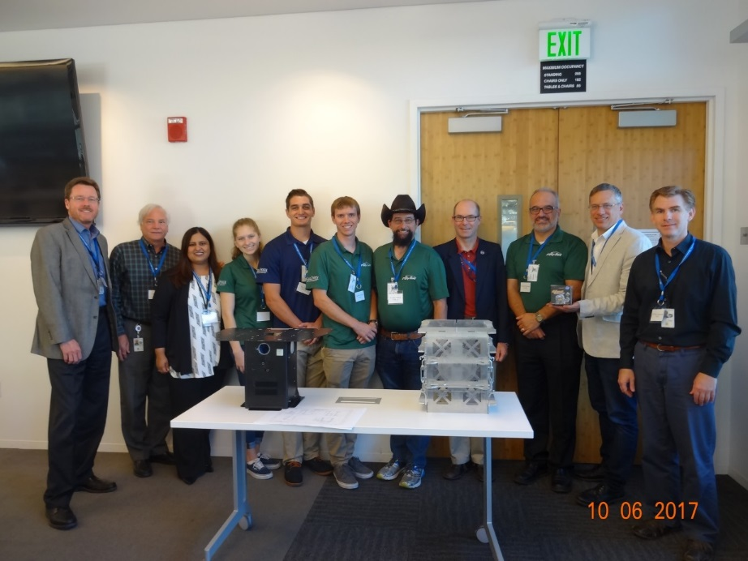
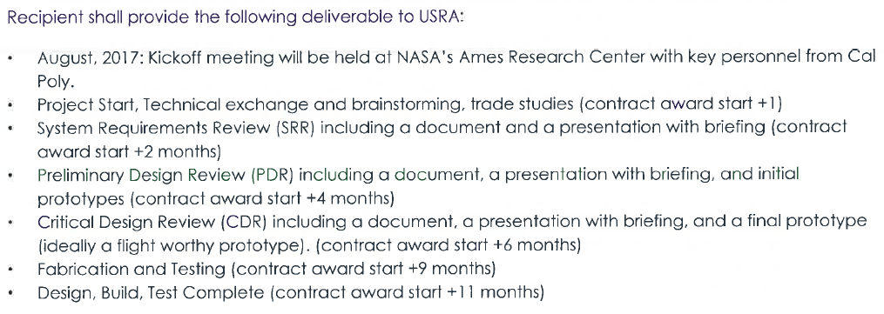
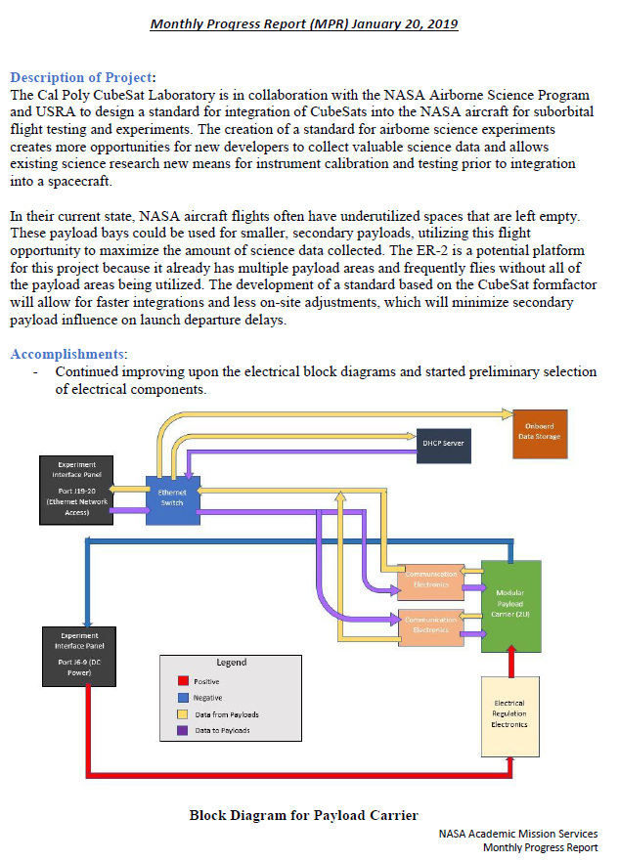
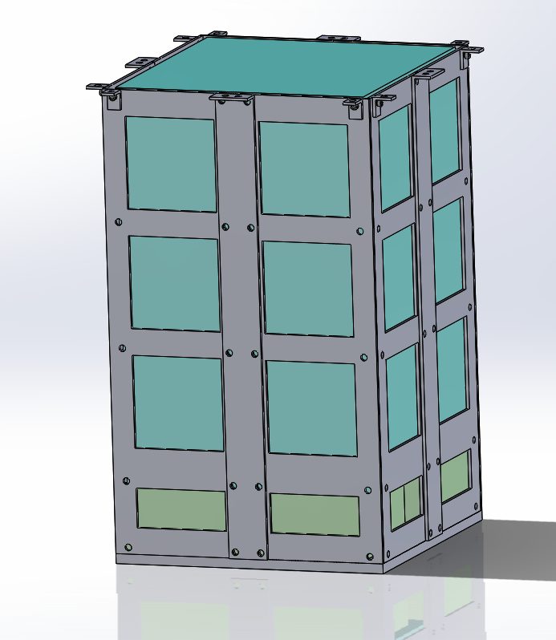

NASA Funded IRAD – Test Bed for CubeSat Instruments
Deliverables
Monthly Reports
CAD Model of the 6-U
CubeSat carrier
10/23/2018 Kickoff meeting
11/02/2018 1st Weekly Tagup
9/11/2018
Task Mod Approved
9/28/2018
Subcontract Fully Executed

Slide 23
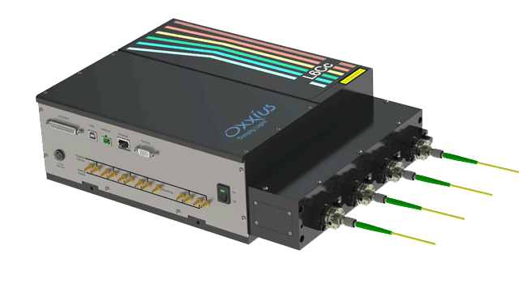
USRA Funded Enhancement to the ASF Calibration Laboratory
A NIST-traceable calibration facility managed by USRA, is designed for airborne systems, it performs spectral and radiometric measurements for instruments both at Ames and other NASA centers.
USRA-funded the purchase of a $53,000 fiber laser system (below, L) which, when interfaced to a large integrating sphere (below, C) will enable full-field characterizations of a new class of push-broom imaging devices (e.g. PICARD) as well as a variety of similar systems both in NASA, and across the remote sensing community.

Slide 24
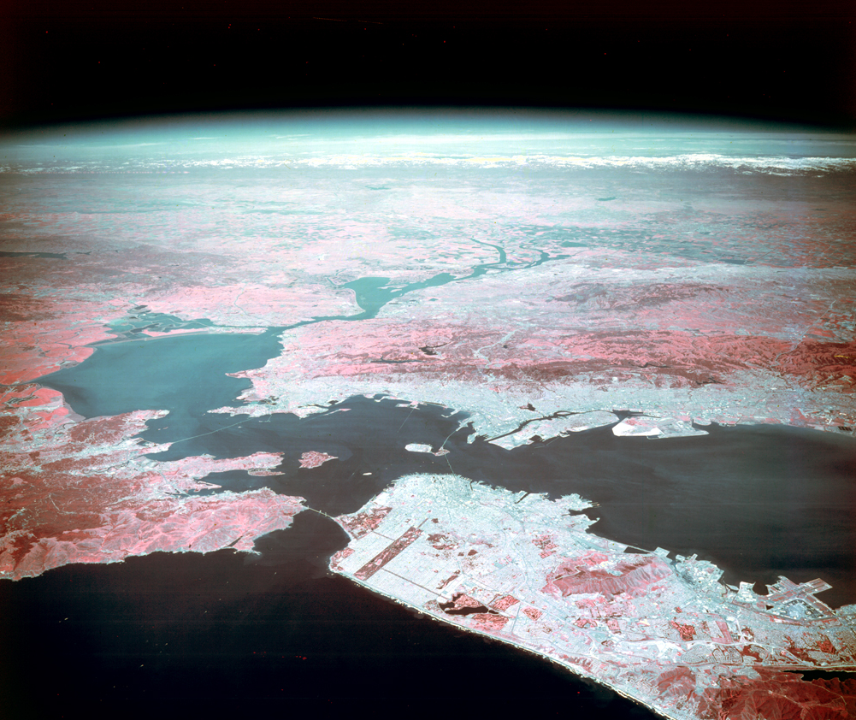



The Ames Airborne Sensor Facility is supported by the
NASA Earth Observing System Project Science Office at GSFC and the Airborne Science Program at NASA HQ
and is staffed by USRA.
San Francisco from a NASA U-2 at 65,000 ft

