Slide 1
NASA Aerial Film 9” BROWSE Archive
Physical Organization
Airborne Sensor Facility
Ames Research Center

Slide 2
BROWSE CAN (600’ Aerial Film Can) Labeled with a 3 Digit + Sequence ID, type, format and a list (in order) or the rolls found within the can
Title
Frisket
3403 04303
3404 04303
3405 04303
Title
Frisket
8313 04002
8314 04002
8315 04002
8315 04002
Title
Frisket
3893 04108
3894 04108
Each can contains one to twelve rolls of film. Contents are determined by film type (Color or B/W), frame format (9x9 or 9x18) and emulsion type (original vs second-generation).
Initially the Browse was made of second-generation film. In later years, the budget precluded this copy, and the original film was used. Some investigators (i.e., USDA Forest Service), preferred delivery of original film. Browse compilations in those cases were always second-generation.
If the can does not explicitly note “Original”, it is a second-generation film product.

Slide 3
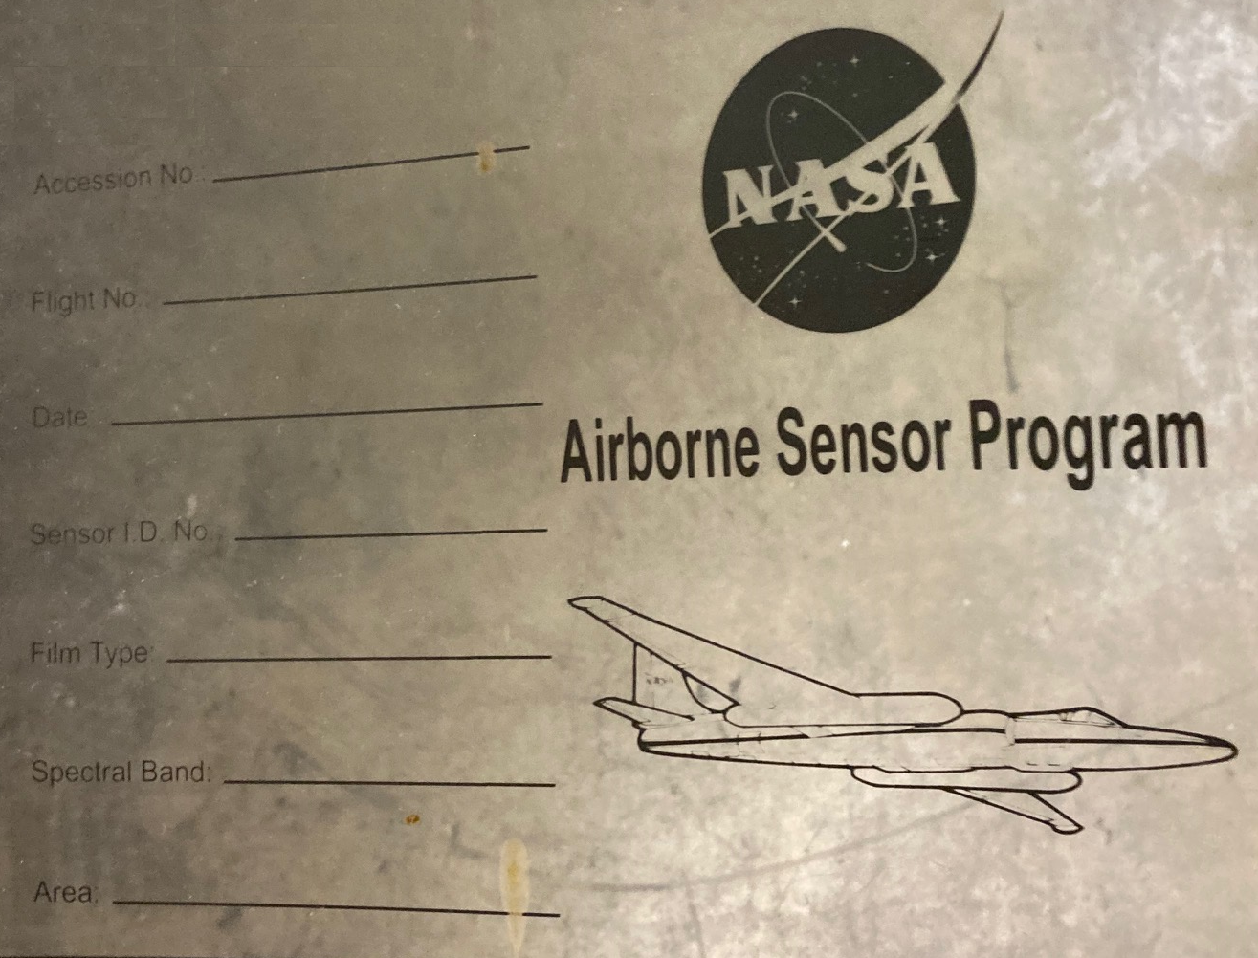
Title Frisket

Slide 4
Title Frisket Information Contents
Accession No: 05680 ← Roll identifier is always a five digit number
Flight No: 02-628 or 02-002-03 ←Format is Aircraft specific FY-Number
Date: 12 May 2002 (132) ← As “Day” “Month” “Year” (Julian Day)
Sensor ID No: 034 ← Unique Camera ID always a three digit number
Film Type: SO-134 ← Film emulsion loaded into camera
Spectral Band: 510-900nm ← Spectral response per film and lens filter
Area: Southeast States ← General geographic coverage of frames

Slide 5
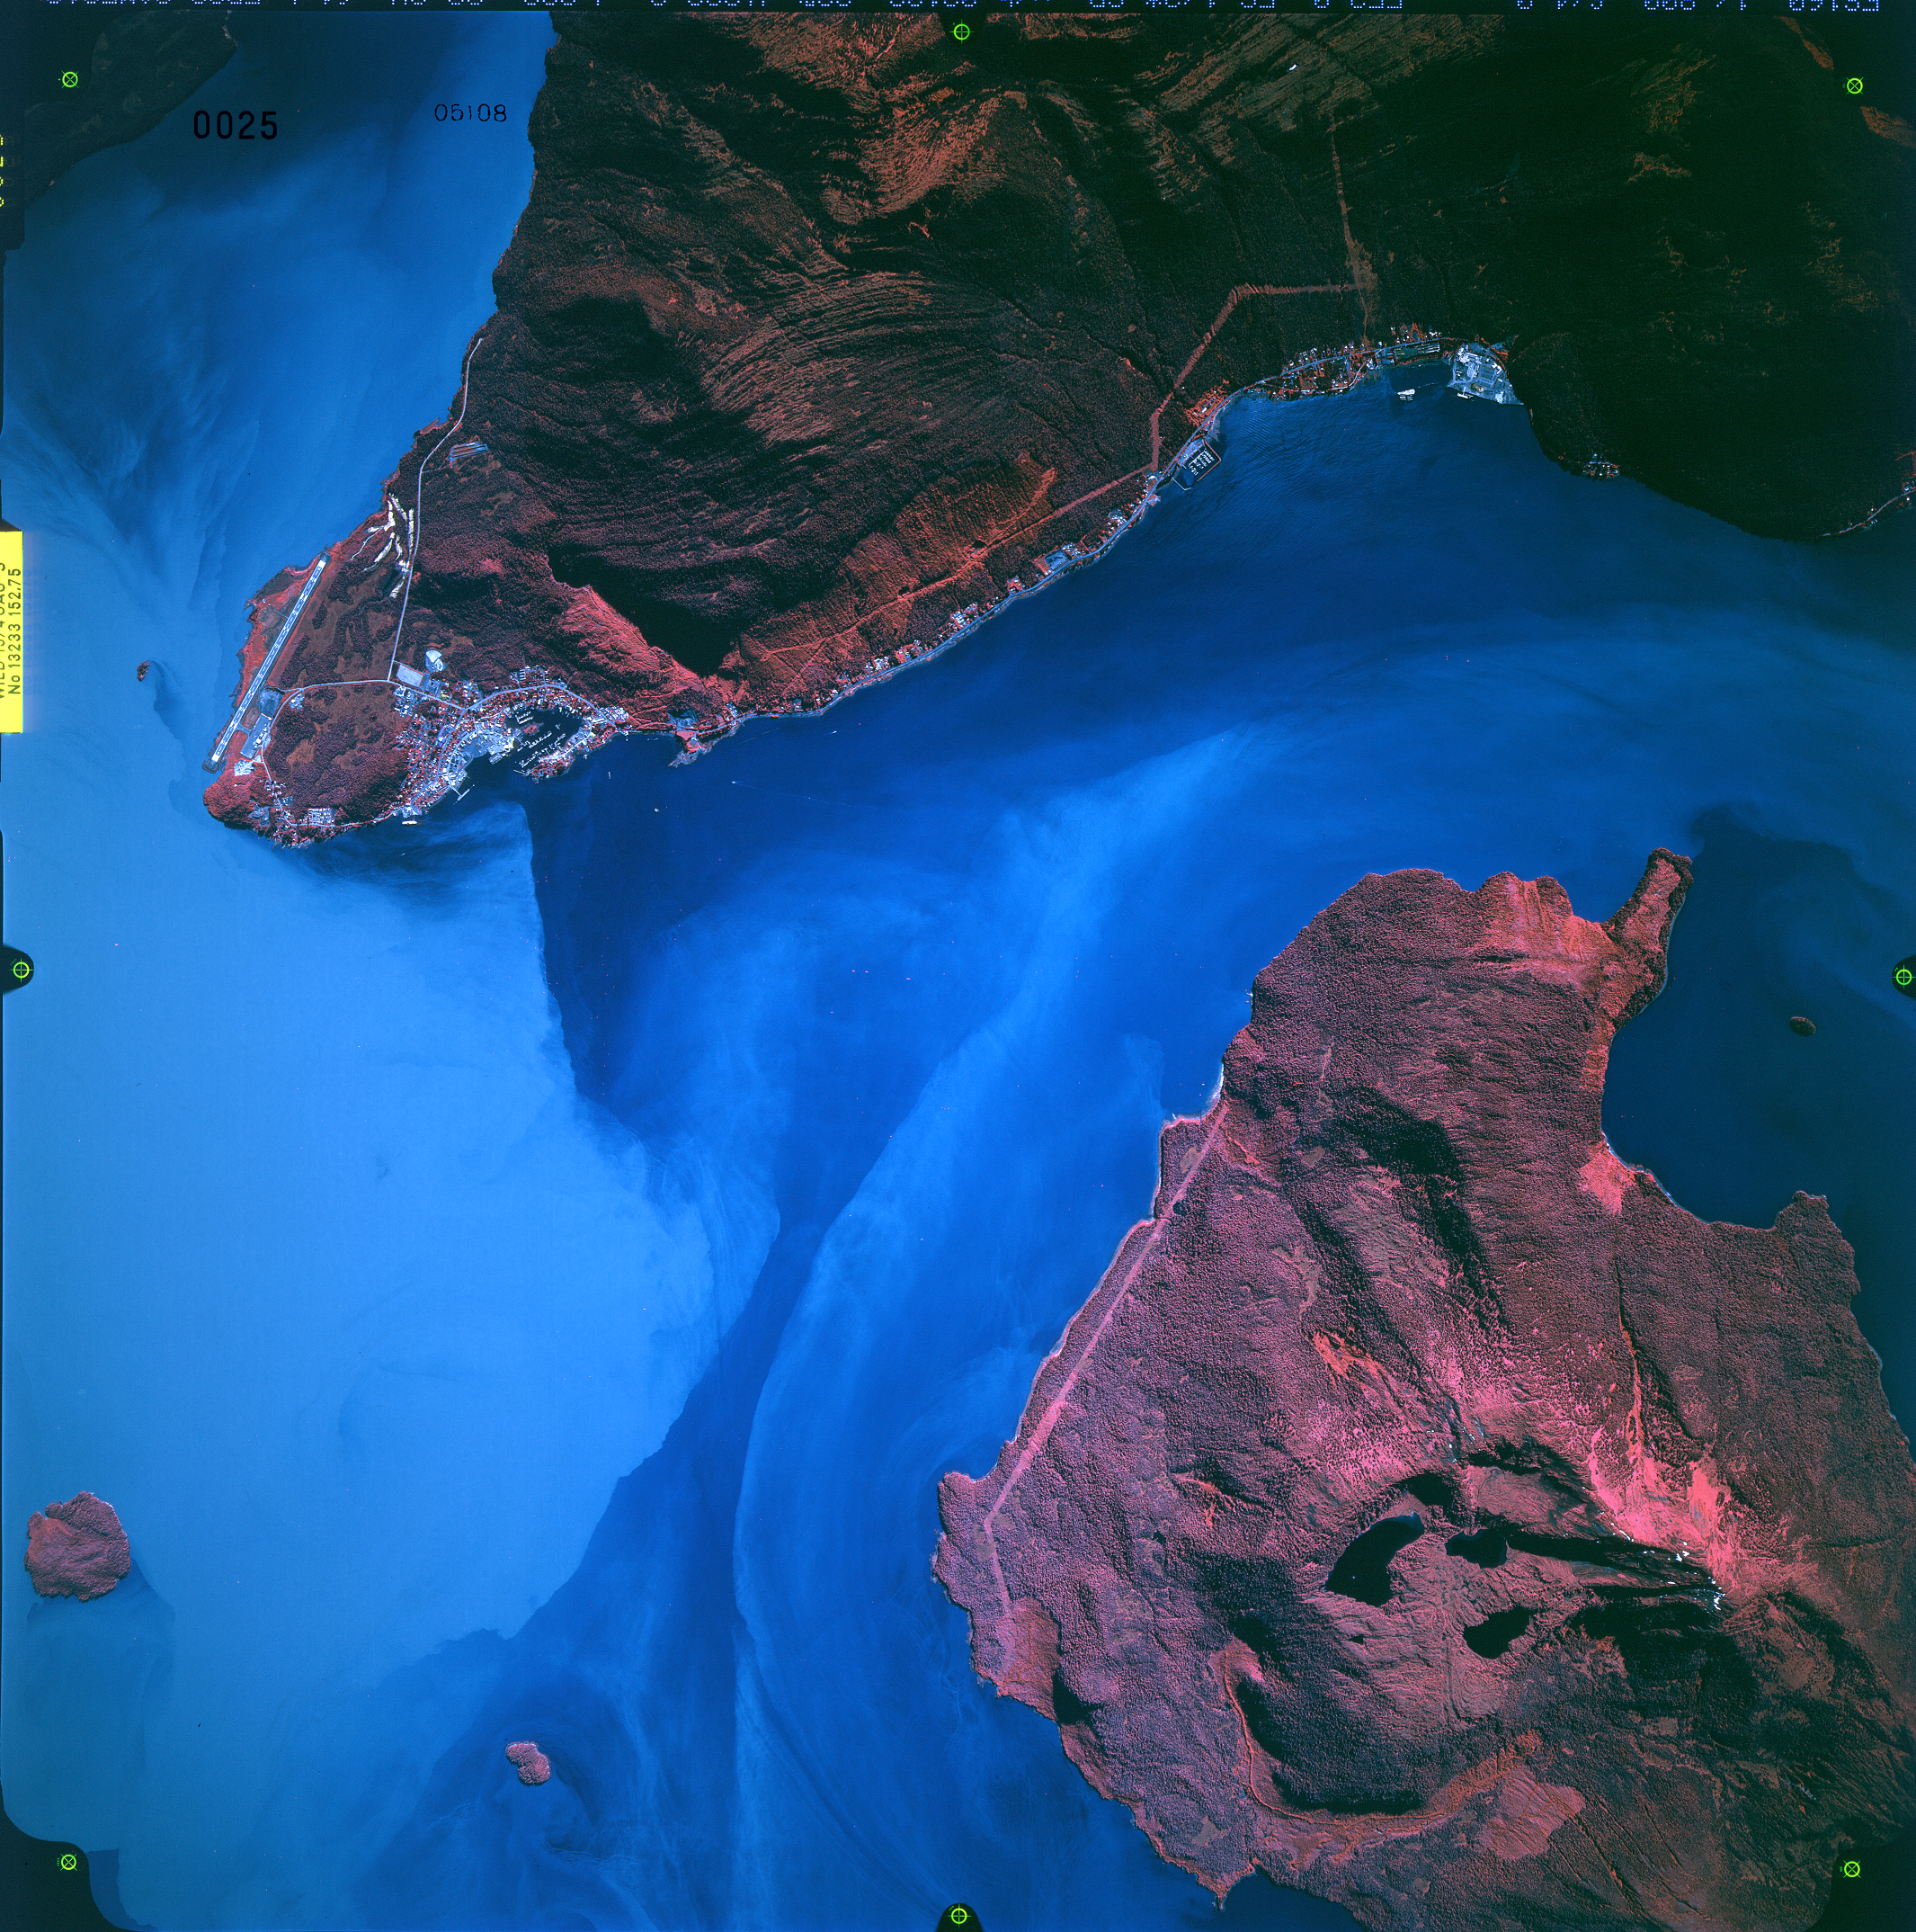
Each exposure has a unique identifier stamped in the upper left corner. It’s the frame number followed by the roll number.
In this example Frame 0025 Roll 05108
Some cameras image the lens installed, in this example
The camera is an RC-30 Sensor #017

